Slide 1
3RD LEVEL FINANCE
REGISTRATION FEE FOR COLLEGE – 3000 EURO
CAPITATION GRANT – 165 EURO
PLC STUDENT SERVICES FEE – APPROX 500 EURO
DROP OUT? – FULL FEES FOR NEXT ACADEMIC YEAR UNLESS YOU LEAVE BY 31 OCT-SLIDING SCALE
CAN CHANGE COURSES - 15 OCT. (must have points/entry requirements) FACULTY OFFICE

Slide 2
GRANT LEVELS
SEE WWW.SUSI.IE AND HANDOUT
APPLICATION OPENS IN APRIL 2015

Slide 3
WWW.ACCESSCOLLEGE.IE
DARE PROGRAMME
STUDENTS WITH A DISABILITY
HEAR PROGRAMME
DISADVANTAGED BACKGROUNDS

Slide 4
DARE SCHEME
TICK DISABILTY BOX ON CAO
BENEFITS- GET INTO COURSE ON LOWER POINTS/SUPPORTS IN COLLEGE

Slide 5
Disabilities eligible for consideration
  Autistic Spectrum Disorders (including Asperger’s Syndrome)
  ADD/ADHD
  Blind/Vision Impaired
  Deaf/Hard of Hearing
  DCD – Dyspraxia/Dysgraphia
  Mental Health Conditions
  Neurological Conditions (Brain Injury, Epilepsy, Speech & Language Disabilities)
  Significant Ongoing Illness
  Physical Disability
  Specific Learning Difficulty (Dyslexia & Dyscalculia)

Slide 6
Supports in College
You don’t have to be eligible for DARE to get support in college – APPLY ANYWAY TO LET COLLEGE KNOW YOUR SITUATION
A needs assessment is conducted to identify your specific support requirements.
Supports may include:
  Orientation Programmes
  Learning Support
  Assistive Technology
  Library Support
  Exam Support
  Note-taking/Support Worker
  Academic Tuition

Slide 7

What is HEAR?
Higher Education Access Route is an admissions route for school leavers who for social, financial or cultural reasons are under-represented at third level education.
It was set up to ensure that all Leaving Certificate students have a fair and equal opportunity to progress to third level education.

Slide 8


Where can I go to college?
St. Angela’s College, Sligo
- Maynooth University
- Pontifical University,
Maynooth
- Dublin Institute of Technology
- Dublin City University
(incorporating
Mater Dei Institute of Education & St.
Patrick’s College, Drumcondra)
- RCSI
- Trinity College, Dublin
- University College, Dublin
- Church of Ireland, College of Education
- Marino Institute of Education
- National College of Ireland
NUI Galway
University of
Limerick
Mary
Immaculate
College
University
College Cork

Slide 9
Should I apply?
1. | Was your household income on or below €45,790 in 2013?
2. | Do you or your family have a Medical Card/GP Visit Card?
3. | Did your parents/guardians receive a means-tested social welfare payment for at least 26 weeks in 2013?
4. | Is your parents’ or guardians’ employment status under-represented in Higher Education?
5. | Have you attended a DEIS second level school for five years?
6. | Do you live in an area of concentrated disadvantage?

Slide 10


Talk to your parent /
guardian

Slide 11
STUDENT ASSISTANCE FUND
Books
Class materials
Rent
Heating/lighting bills
Food
Travel of an urgent or essential nature
Medical expenses, i.e. doctor or dental visits
Expenses associated with family breakdown
Expenses associated with bereavement
Expenses associated with accidents
Childcare
Compulsory study abroad

Slide 12
SCHOLARSHIPS
SPORT – CHECK WEBSITE
ACADEMIC- AWARDED AUTOMATICALLY
CREDIT UNION/GARDAI
DE PUY IRELAND – CIT BIOMEDICAL ENGINEERING
UCC – QUERCUS – FEB 1ST 2015

Slide 13
HOW TO APPLY
CONTACT FEES OFFICE IN YOUR COLLEGE
CONTACT STUDENTS UNION

Slide 14
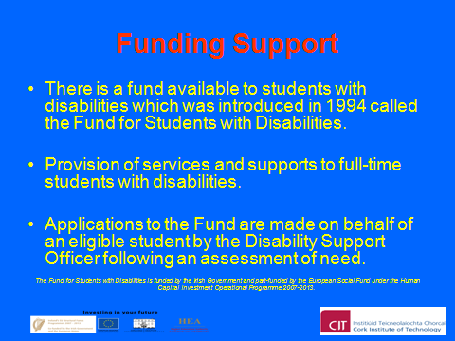
DISABILITY FUNDING

Slide 15

Process
Register with Laura O’Rourke, Disability Support Officer Attend classes for a week or so
Attend ‘needs assessment’ with Disability Officer and Disability Facilitation Administrator
Determine supports you may need
Fill in forms – consent, funding application etc

